Slide 1

MACHINE LEARNING USE CASES
IN ENTERTAINMENT
PRESENTED BY,
C.KEERTHANA
III – CSE
NEHRU INSTITUTE OF TECHNOLOGY

Slide 2

AI Vs HUMANS
AI is a tool not a Threat.
Human Intelligence uses their Brain, Memory and Cognitive abilities while AI relies on the data provided by the Human.
AI is a tool that can help people increase their productivity.

Slide 3

FRAUD DETECTION
ML models can be used to detect fraud in Video Games.
It detects fraudulent activity and flags it for further investigation.
Next Big Thing : Cloud Gaming

Slide 4



APPLICATIONS THAT USES MACHINE LEARNING ALGORITHMS IN ENTERTAINMENT

Slide 5

PERSONALIZATION
Netflix collect and analyze vast amount of user Data.
That includes,
Search History
Rating
Time spent on different content

Slide 6
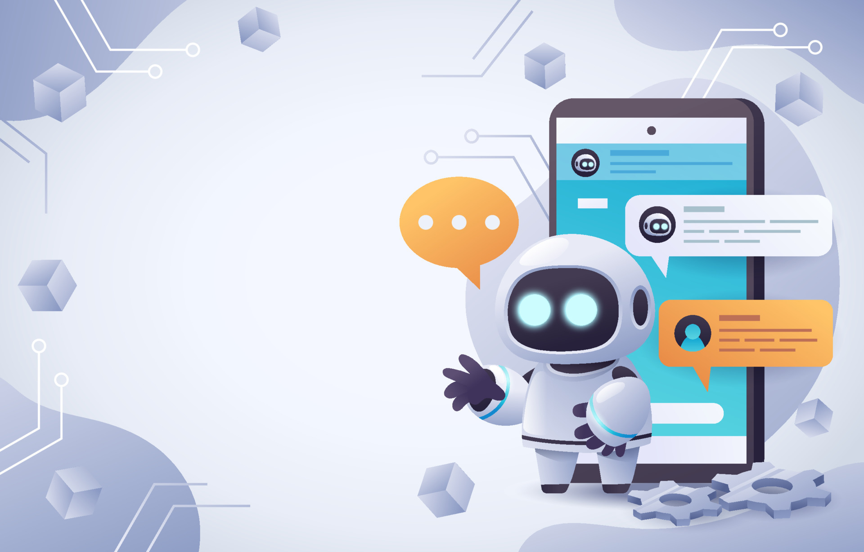
CHATBOT
Modern Chatbots uses Natural Language Processing (NLP) to understand user questions and automate response to them.
To interact and assist Users.

Slide 7

DOES AI REPLACE HUMANS ?
AI will not completely replace humans,
but people who use AI will replace those people who do not use.
Maximize its benefits and minimize its negative impact.

Slide 8

DISADVANTAGE OF AI
High Cost
Privacy Concern
Deepfakes
Unemployment
Make Human Lazy
Emotionless
Algorithmic bias caused by bad data

Slide 9
